Slide 1
The Human Immune System
Identifying and Fighting Disease

Slide 2
I. The Lymph System
Definition: Lymph is the liquid that drains from the blood into the lymph vessels (tubes).
Lymph vessels are small tubes that exist along side of the blood vessels.
a) Structure: The lymph system is composed of lymph vessels, lymph nodes, and organs.
b) Functions:
1. The absorbtion of excess body fluid and its return to the blood stream.
2. The absorption of fat (in the villi of the small intestine).
3. The harvesting and maturation of components of the immune system.

Slide 3
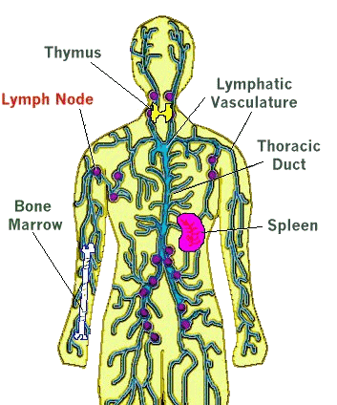
c) Lymph vessels are closely associated with the circulatory system vessels.
Larger lymph vessels are similar to veins.
Lymph capillaries are scattered throughout the body. Muscle contraction causes movement of the lymph fluid through valves.

Slide 4
The lymph that is drained from the body passes through structures called lymph nodes.
Lymph nodes are specialized structures which are populated by white blood cells (lymphocytes and macrophages).
Lymph nodes occur along the entire length of the lymph system.
Lymph nodes are found in larger clusters in the arm pit area, pubic region, and cervical regions of the body.

Slide 5
II. Immunity
a) Immunity is the body's ability to fight off foreign substances and cells.
b) The Lines of Defense
1. First Line of Defense: The Physical Barriers
The first line of defense involves blocking the entry and spread of pathogens (disease-causing agents).
The skin prevents pathogens such as bacteria and viruses from infecting underlying cells and tissues.
Tears and saliva secrete enzymes that breakdown bacterial cell walls.
Mucus glands in the respiratory, digestive, urinary, and reproductive systems produce mucus that forms another barrier.

Slide 6
2. The Second Line of Defense: The Inflammatory Response
Damaged cells release the chemical histamine that causes the affected area to become swollen, heated and reddened.
The heat makes the environment unfavorable for microbes, and promotes healing.
Phagocytes (a type of white blood cell) clean up dead microbes, cells, and debris.

Slide 7
3. The Third Line of Defense: Specific Defenses
The third line of defense is more effective than the first and second lines. It has a memory component that improves response time when an invader encountered.
Immunity occurs when a specific type of pathogen can longer cause illness in an organism.
Immunity results from the production of antibodies that are specific to a given antigen.
Antibodies bind to antigens in a lock-and-key fashion and kill or inactivate the invaders.
Antigens can be any molecule that causes antibody production.
Ex: ???

Slide 8
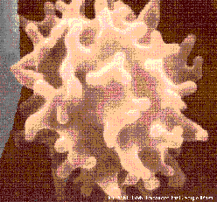
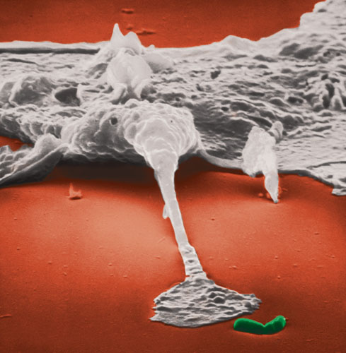
III. WHITE BLOOD CELLS
White blood cells are known as leukocytes.
They function in fighting disease.
They are made from stem cells in bone marrow.
http://staff.jccc.net/pdecell/lifeis/wbcell.gif
http://www.creationscience.com/onlinebook/webpictures/macrophage.jpg

Slide 9
White blood cells consist of lymphocytes and phagocytes
a) Lymphocytes
1. B cells are responsible for making antibodies.
2. There are several subsets of T cells:
  killer T cells that kill virus-infected and, perhaps, tumor cells
  helper T cells that help B cells produce antibodies.

Slide 10
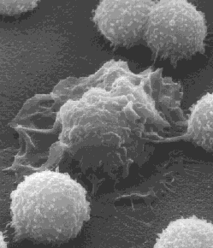
b) Phagocytes engulf foreign material (antigens) that enter the body dead and dying cells of the body.
http://www.cellsalive.com/mac.htm
Courtesy of Drs. Jan M. Orenstein and Emma Shelton

Slide 11
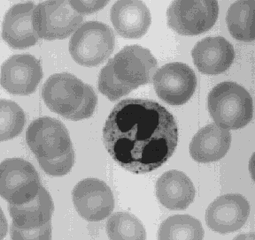
The phagocytes squeeze into infected tissue where they kill the invaders (e.g., bacteria) and then engulf the remains by phagocytosis.

Slide 12
Some White Blood Cells cause inflammation at the site of infection by releasing histamine.
These White Blood Cells play an important part in some allergic reactions such as hay fever and anaphylactic shock to insect stings.

Slide 13
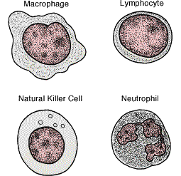

Slide 14
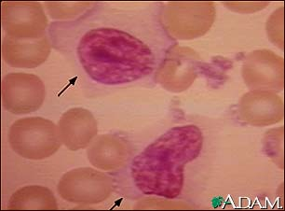
WBC
RBC

Slide 15
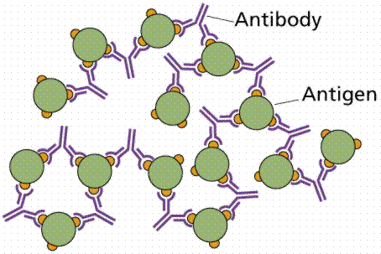
IV. Antibodies and Antigens Antibodies recognizes and binds to the antigen leading to its destruction.
Formation of an antigen-antibody complex. Image from Purves et al., Life: The Science of Biology, 4th Edition, by Sinauer Associates (www.sinauer.com) and WH Freeman (www.whfreeman.com), used with permission.

Slide 16
V. Vaccination
a) Vaccination is a term derived from the Latin vacca (cow, after the cowpox material used by Edward Jenner in the first vaccination).
b) A vaccine causes antibody production and formation of memory cells (B-cells).
c) Vaccines are made from killed or weakened pathogens that cause antibody production but not the disease.
Recombinant DNA techniques can now be used to develop even safer vaccines.
d) Active immunity develops after an illness or vaccine.
e) Passive immunity is the type of immunity when the individual is given antibodies to combat a specific disease. Passive immunity is short-lived.

Slide 17
VI: Blood Types, Rh, and Antibodies
a) All cells (including Blood cells) have antigens on their cell membrane.
Blood cells that have different antigens belong to different blood groups or blood types. Ex: A, B, AB, O
b) In a blood transfusion, the blood groups of the recipient and donor must be matched.
If not matched, the recipient's immune system will produce antibodies causing clotting of the received cells, blocking circulation through capillaries and producing serious or even fatal results.

Slide 18
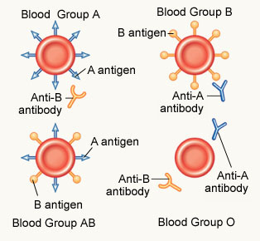
Antigens and Antibodies of Human Blood. Fromhttp://www.ethal.org.my/opencms/opencms/ethal/resources/MedicalGeneral/026rmgBloodType.html

Slide 19
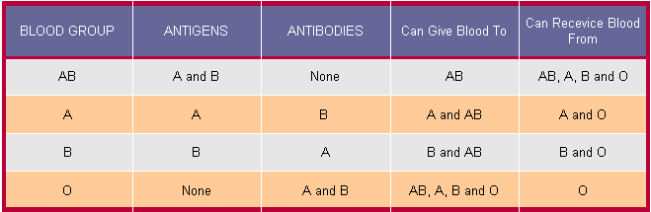
e) Blood Types: Donors and Recipients
1. People with type AB blood can receive blood of any type (universal recipient).
2. Those with type O blood can donate to anyone (universal donor).
Human Blood Types. From http://www.ethal.org.my/opencms/opencms/ethal/resources/MedicalGeneral/026rmgBloodType.html

Slide 20
f) The Rh Factor
1. The Rh Factor (for the rhesus monkey in which it was discovered) blood group is made up of those individuals who can either make the Rh antigen Rh positive (Rh+) or not (Rh negative (Rh-).
2. Because the mother and newborn can have different Rh factors, blood clotting and potential death could occur if their blood mixes during childbirth.
To prevent this, mothers are given an injection that prevents her from building up antibodies against the newborn’s blood.

Slide 21
VII. Organ Transplants and Antibodies
a) Success of organ transplants and skin grafts requires a matching of antigens that occur on all cells in the body.
1. No two individuals, even in a family, will have the same identical antigens.
2. However, the best matches are going to occur within a family. The preference order for transplants is identical twin > sibling > parent > unrelated donor.
Identical twins are a 100% match.
Chances of an unrelated people having matching antigens is the between 1 in 100,000-200,000. Matches across racial or ethnic lines are often more difficult.

Slide 22
VIII. Allergies
a) The immune system can overreact, causing allergies or autoimmune diseases.
b) Allergies result from immune system being too sensitivite to antigens that do not cause an immune response in most people.
c) Allergens are substances that cause allergies, include dust, molds, pollen, cat dander, certain foods, and some medicines (such as penicillin).
Up to 10% of the US population suffer from at least one allergy.
d) Cells release histamine when encountering an allergen which starts to cause inflamation. In some individuals the histamine release causes life-threatening anaphylactic shock.

Slide 23
IX. Disorders of the Immune System: Autoimmune and Immunodeficiency Disorders
a) The immune system usually distinguishes "self” ( what cells should be there) from "nonself” (what cells should not be there) . The immune system learns the difference between cells of the body and foreign invaders.
b) Autoimmune diseases result when the immune system attacks and destroys cells and tissues of the person’s own body.
Ex: Juvenile diabetes, Grave's disease, Multiple sclerosis, Systemic lupus erythematosus, and Rheumatoid arthritis.

Slide 24
c) Autoimmune diseases: Types and Characteristics
1. Multiple sclerosis (MS) is caused by antibodies attacking the coverings of nerve cells.
2. Lupus has the person forming a series of antibodies to their own tissues, such as kidneys (the leading cause of death in SLE patients) and the DNA in their own cellular nuclei.
3. Rheumatoid Arthritis sufferers have damage to their joints.
4. Some evidence supports Type I diabetes as an auto immune disease. Juvenile diabetes results from the destruction of insulin-producing cells in the pancreas.

Slide 25
d) Immunodeficiency Diseases
1. Immunodeficiency diseases result from the lack or failure of one or more parts of the immune system.
Affected individuals are susceptible to diseases that normally would not bother most people.
Genetic disorders, Hodgkin's disease, cancer chemotherapy, and radiation therapy can cause immunodeficiency diseases.

Slide 26
2. Types of Immunodeficiency Diseases
Severe Combined Immunodeficiency (SCID) results from a complete absence of the immune responses. Affected individuals suffer from a series of seemingly minor infections and usually die at an early age.
EX: The boy in the bubble.
QUESTION: Can you think of a way to help cure people with this disease?
Acquired Immunodeficiency Syndrome (AIDS) is currently receiving the most attention among the immune system diseases.
AIDS is a collection of disorders resulting from the destruction of T cells (killer cells) by the Human Immunodeficiency Virus (HIV), a retrovirus.

